Slide 1
THE MAZE
Dipali Gajera (19645)
San Francisco Bay University
Summer, 2022

Slide 2
Contents
_________________________________________________
INTRODUCTION
DESIGN
IMPLEMENTATION
TEST
ENHANCEMENT IDEAS
CONCLUSION
REFERENCE

Slide 3
INTRODUCTION

Slide 4
The depth-first search algorithm is randomized in this algorithm. This method, which is frequently used with a stack, is one of the easiest for creating mazes.
The algorithm picks a random neighboring cell that hasn't been visited yet after starting from a random cell.
In order to facilitate backtracking, the algorithm breaks down the wall separating the two cells, marks the new cell as visited, and adds it to the stack.
This process is carried out repeatedly by the algorithm, with a cell that has no unexplored neighbors being regarded as a dead end.

Slide 5
DESIGN

Slide 6
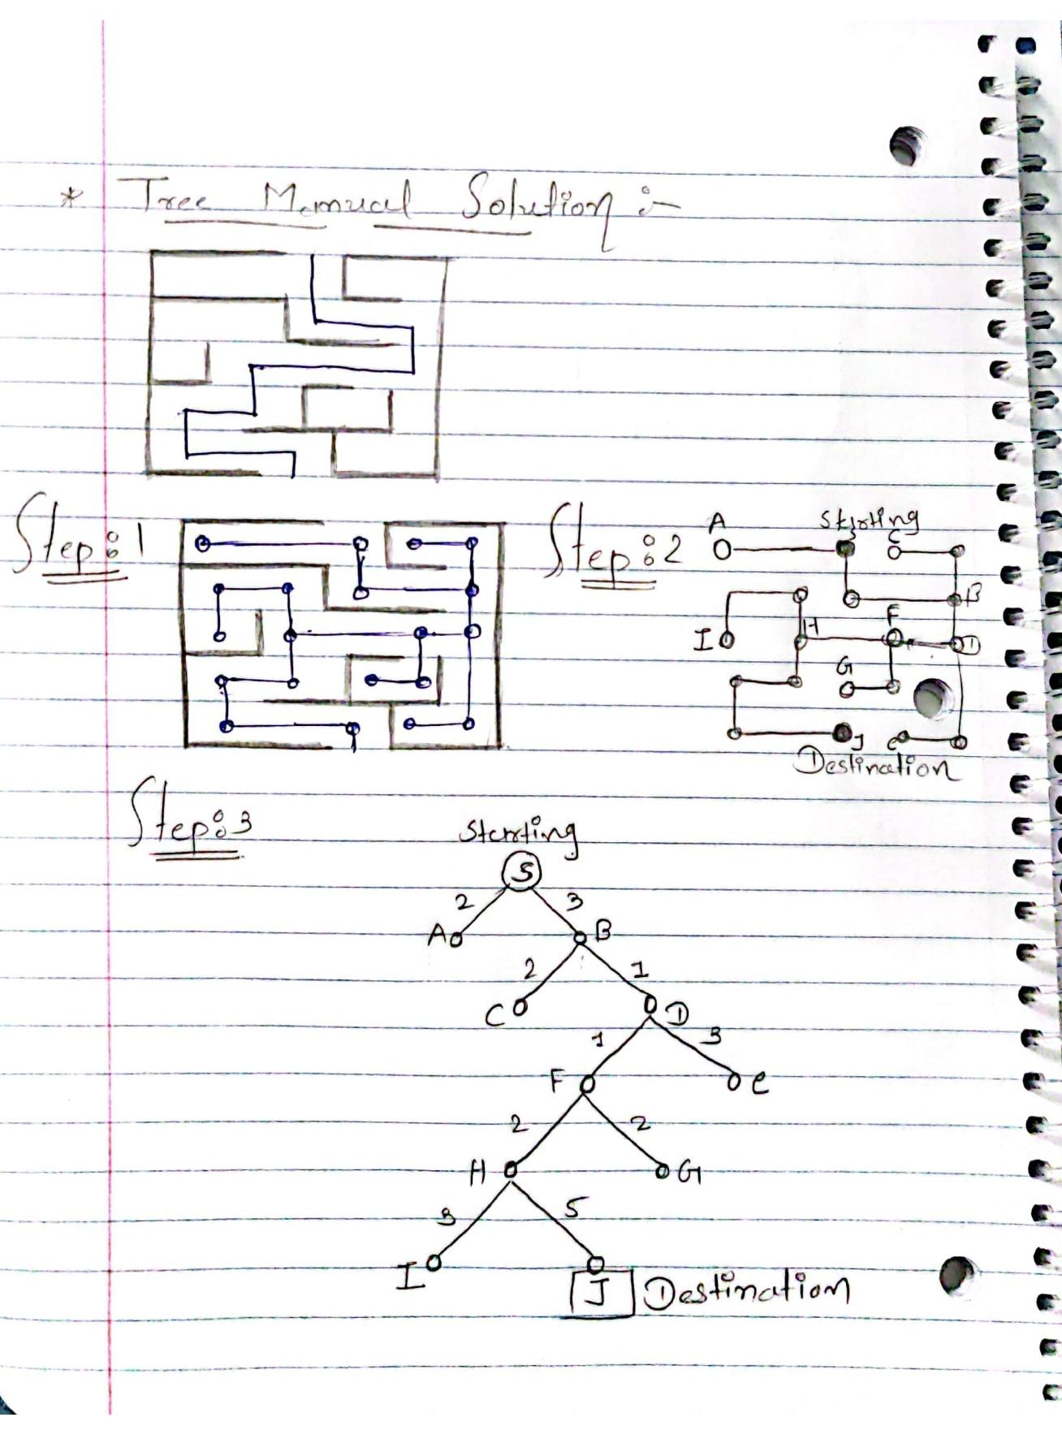
Tree Structure :-

Slide 7
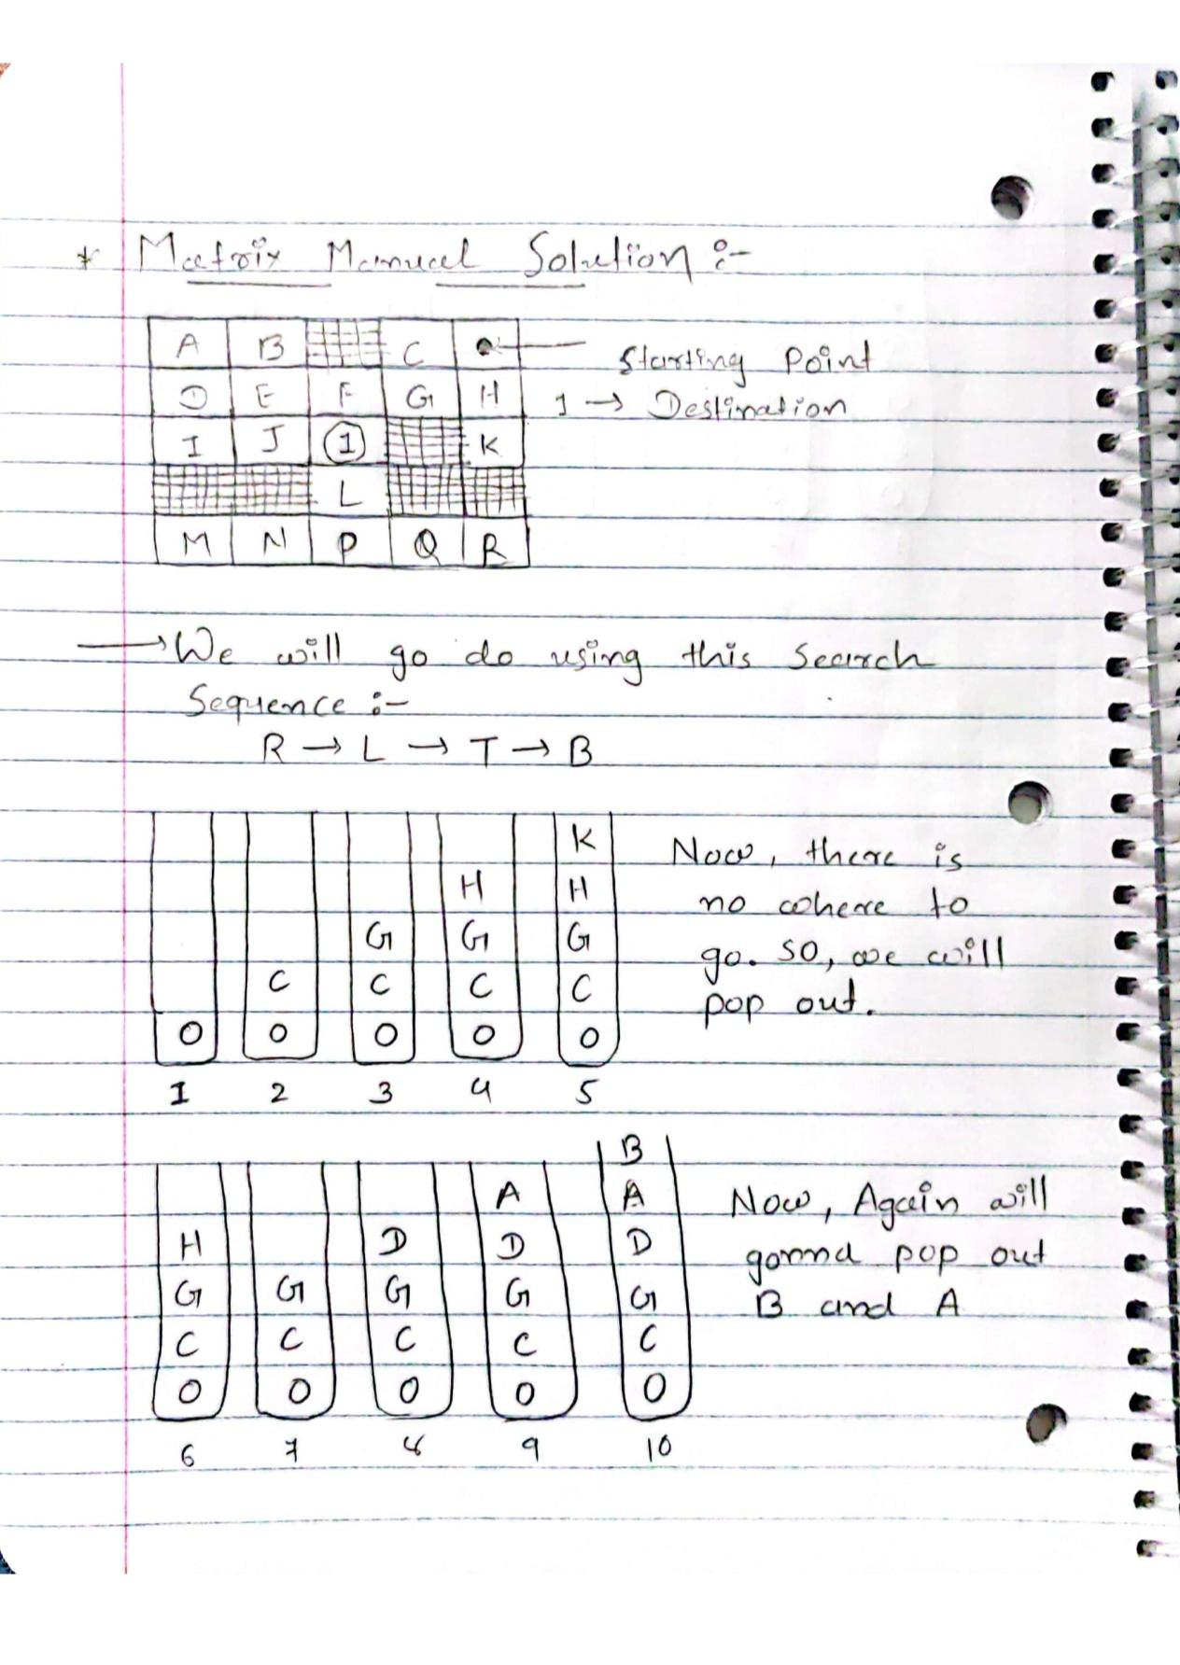
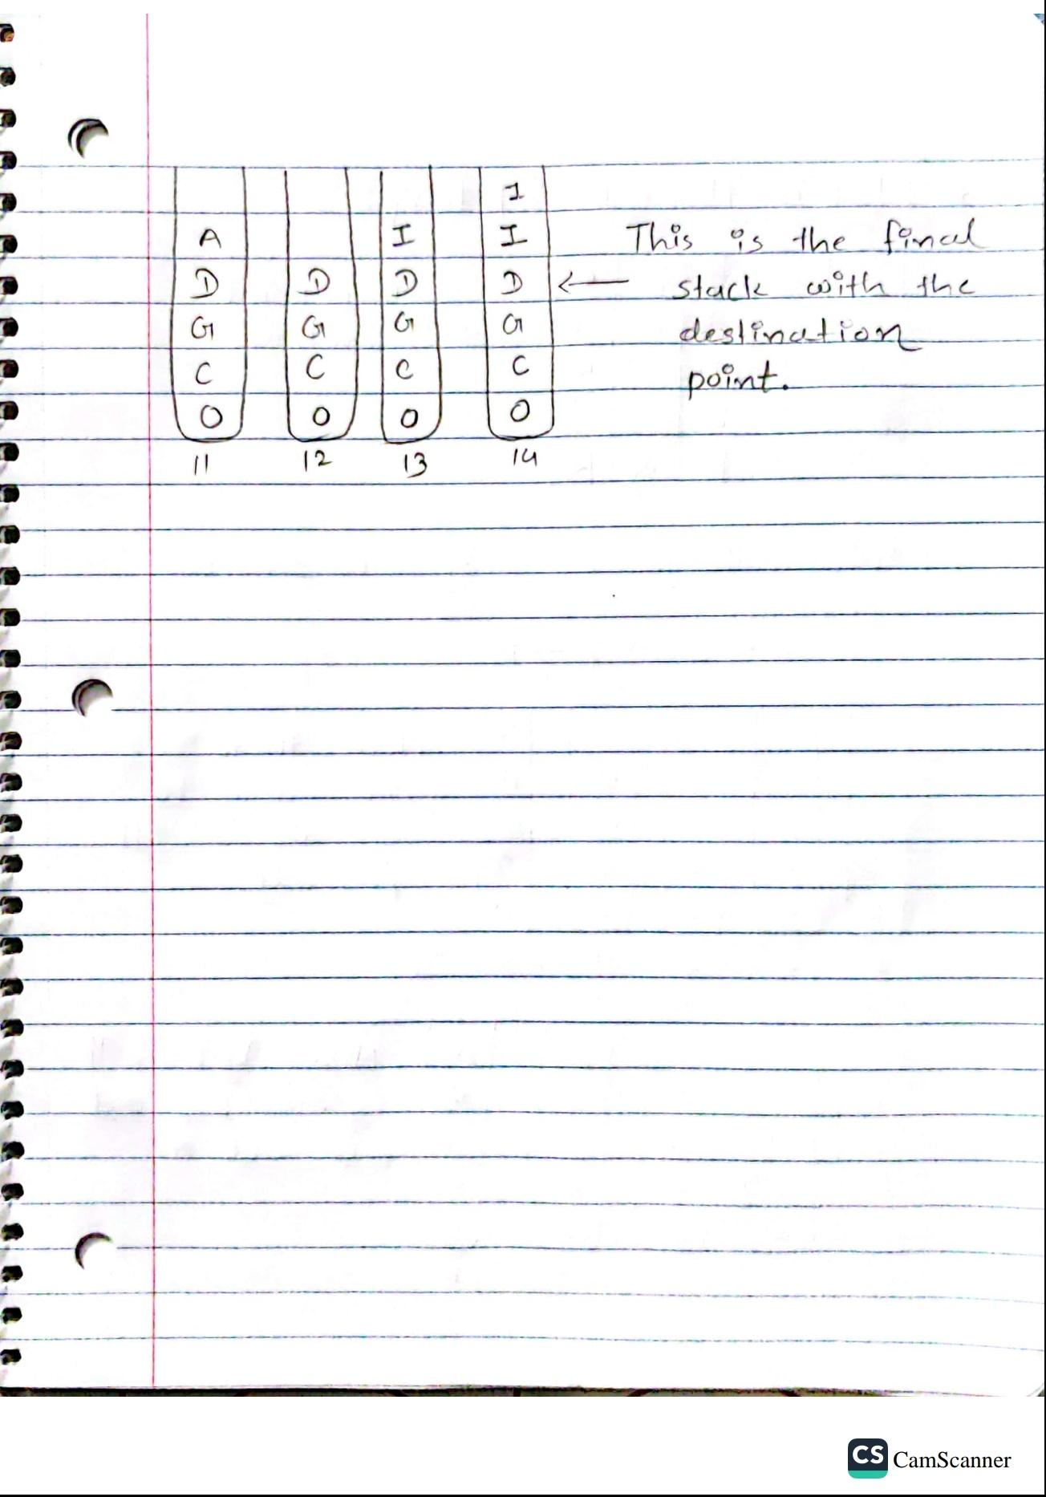
Matrix Solution

Slide 8
IMPLEMENTATION

Slide 9
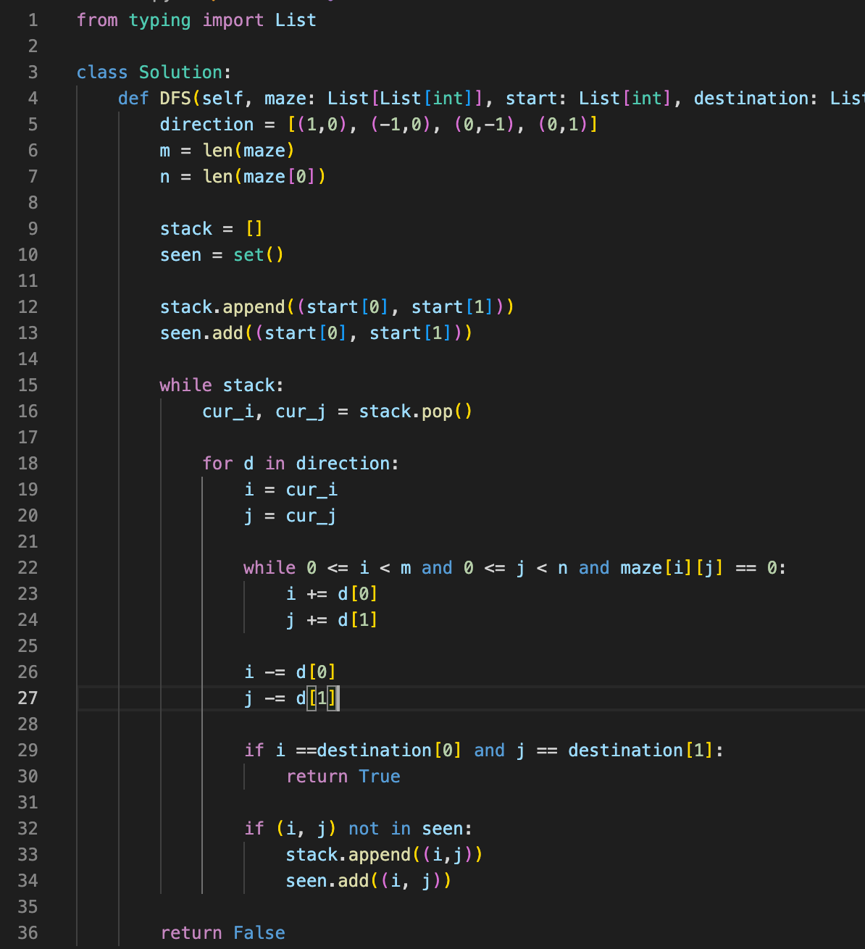

Slide 10
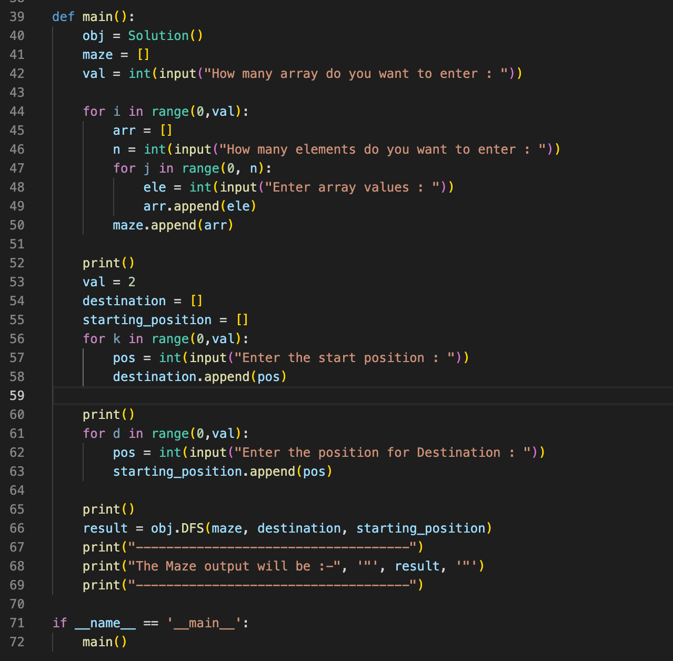

Slide 11
TEST

Slide 12
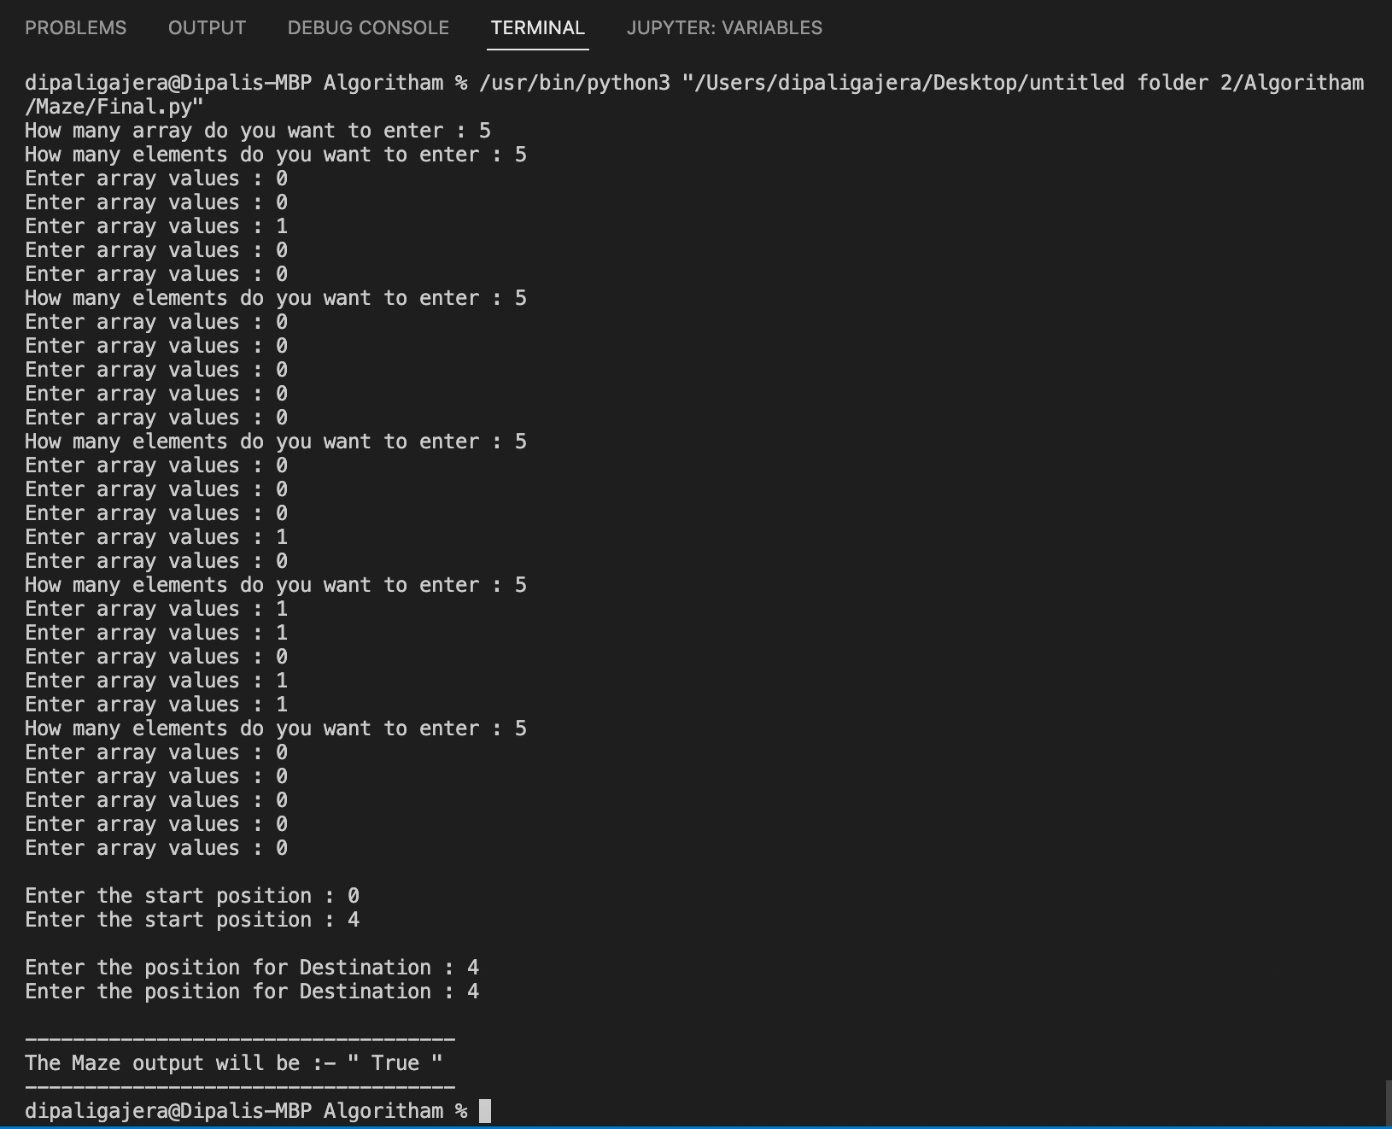

Slide 13
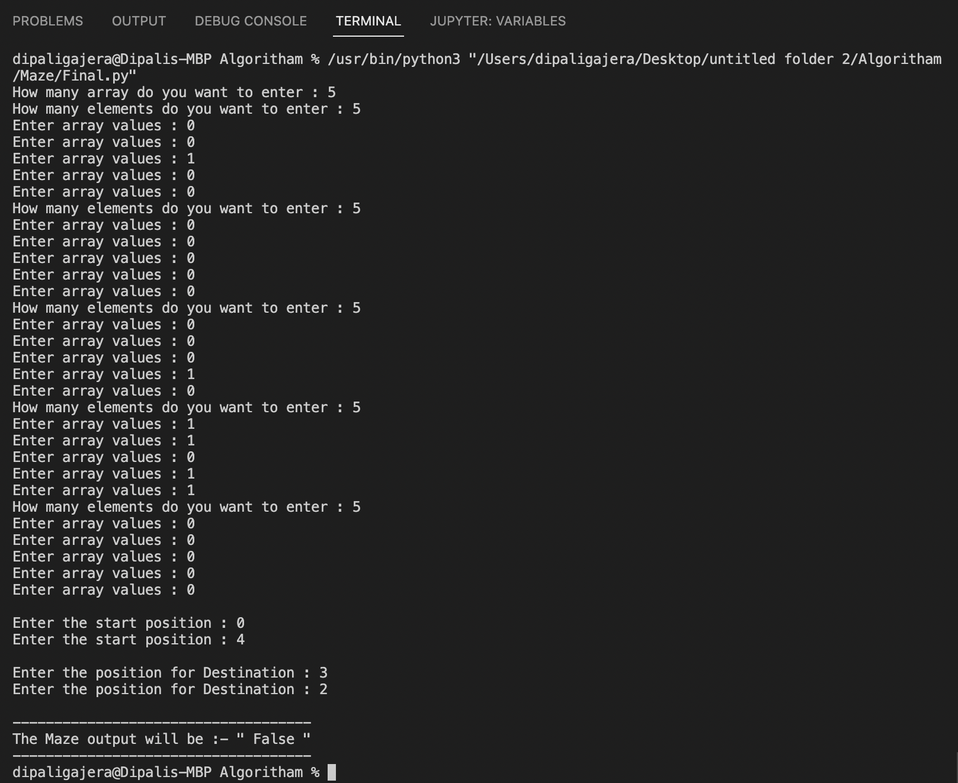

Slide 14
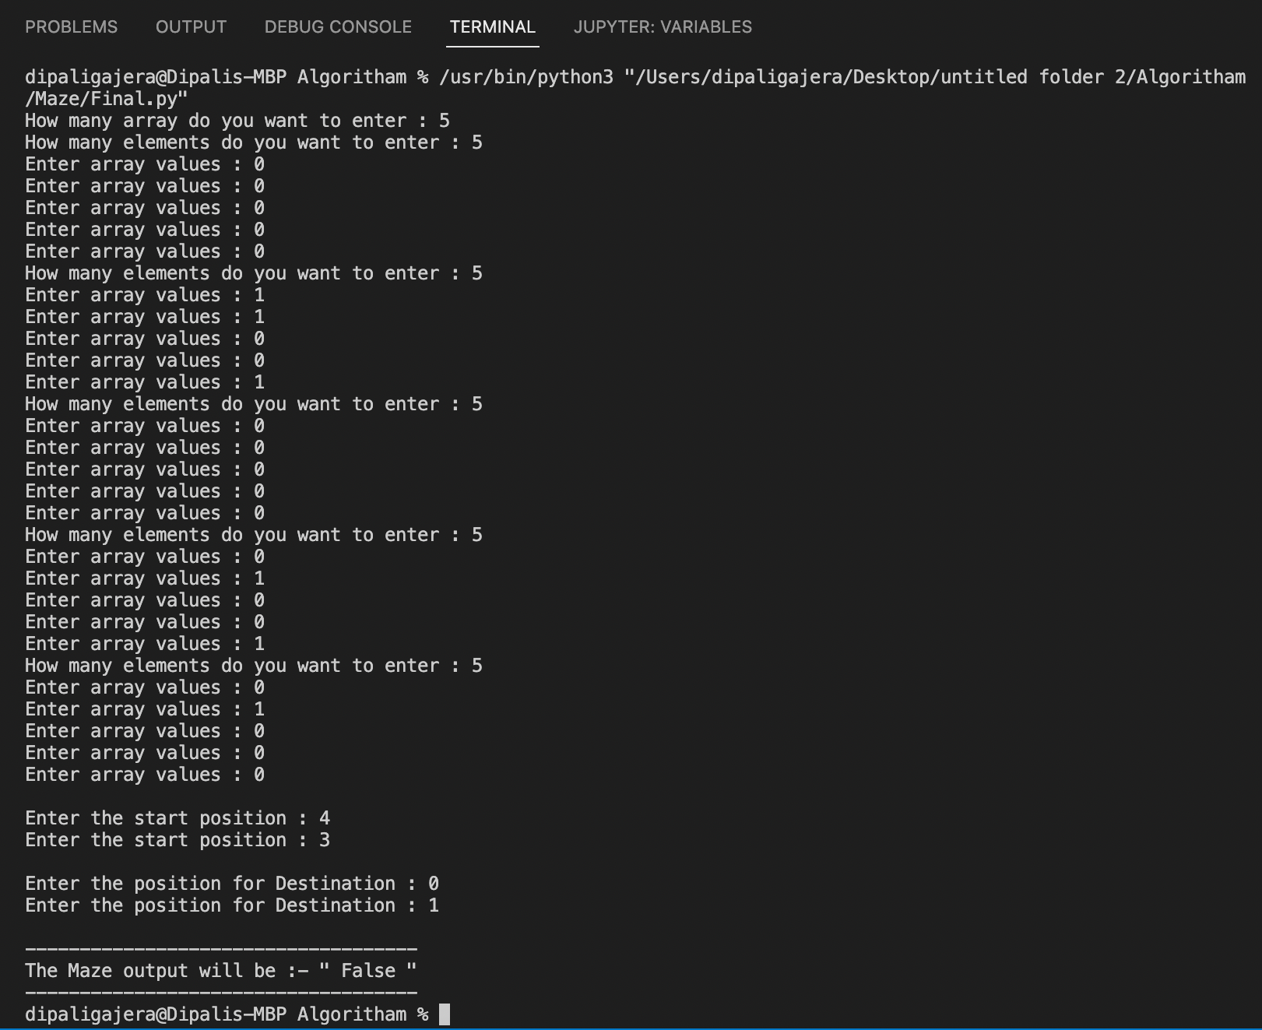

Slide 15
ENHANCEMENT IDEAS

Slide 16
This maze problem, we can also solve this using shortest path algorithm. Like, Dijkstra’s Algorithm and Bellman Ford’s Algorithm.
Another way for this problem is using shortest path, Minimum Spanning Tree(MST).
Converting the maze into X and Y squares is the either way and convert into tree using nodes.
This shortest path is the easiest way to solve this maze problem .
We can apply this algorithm in real world.
For example; Map.

Slide 17
CONCLUSION

Slide 18
From this project, i learned a lot about Depth First Search(DFS) Algorithm and also compare with the other algorithms.
The N, E, W, and S make it easier to move in the necessary directions in order to arrive to the target.

Slide 19
REFERENCE

Slide 20
https://github.com/Areesha-Tahir/BFS-DFS-Maze-Solver-In-Python/blob/main/main.py
https://www.youtube.com/watch?v=sTRK9mQgYuc
https://codereview.stackexchange.com/questions/197356/searching-a-maze-using-dfs-and-bfs-in-python-3
https://makeschool.org/mediabook/oa/tutorials/trees-and-mazes/generating-a-maze-with-dfs/

Slide 21
THANK YOU

